Slide 1
ECON 672
Week 5: Review of Trade Adjustment Assistant Community College and Career Training (TAACCCT) Grant Program Evaluation
Samuel Rowe, PhD 12/22/2022

Slide 2
Overview
Overview of TAACCCT
Overview of Program Evaluation of TAACCCT
Research Questions of Interest
Impact Evaluations
Golden Triangle Modern Manufacturing Evaluation
Innovative Multi-Industry Partnership and Career Training (IMPACT) Project Gateway Community & Technical College Evaluation

Slide 3
Overview of TAACCCT
Trade Adjustment Assistance Community College and Career Training (TAACCCT)
Employment and Training Administration (ETA) in US Department of Labor (DOL) awarded $1.9 billion in grants to 256 grantees between 2011 and 2018
Focused on eligible workers under Trade Adjustment Assistance (TAA) for Workers program and other eligible adults
There were 4 rounds of grants between 2011 and 2018
Purpose of the grants
Build capacity of grantees to provide workforce education and training programs
Provide training and education to unemployed workers and other adult learners to prepare for in-demand jobs
Source: https://www.dol.gov/agencies/eta/skills-training-grants/community-colleges

Slide 4
Overview of TAACCCT
Community college redesigned around 2,600 programs of study to help adults learn new skill
Aligned with the local and regional business needs
498,793 individuals enrolled in the TAACCCT program and 351,202 credentials were earned
Industry aligned curriculums
Accelerated learning strategies
Hands-on experience for job training
5 major sectors for skills alignment:
Health care, manufacturing, energy, information technology, and transportation
Source: https://www.dol.gov/sites/dolgov/files/ETA/TAACCCT/pdfs/TAACCCT-Fact-Sheet-Program-Information.pdf

Slide 5
Overview of Evaluation
National evaluation of TAACCCT
Funded by ETA and US DOL Chief Evaluation Office
Conducted by Urban Institute and Abt Associates
Research questions about TAACCCT were implemented in the DOL Learning Agenda
This document is now required for federal agencies under the Evidence Act of 2018
Required an implementation evaluation and impact evaluation

Slide 6
Program Evaluation of TAACCCT
Four Evaluation Components of TAACCCT grant program evaluation
Implementation Evaluation
Impact Evaluation
Outcome Evaluation
Descriptive Evaluation

Slide 7
Program Evaluation of TAACCCT
Implementation Analysis
Focus on the service delivery approaches developed and the systems changed through the grants based on a survey of college and visits to colleges
Impact Analysis
A synthesis of 3rd party evaluation of the implementation and impact of TAACCCT
Each impact analysis was independently conducted

Slide 8
Program Evaluation of TAACCCT
Outcome Evaluation
Nine of the Round 4 grantees were surveyed and provided admin records to better understand the characteristics of TAACCCT participants, their service received, and their education and employment outcomes
Descriptive Evaluation
Selected Round 4 employer-partners were surveyed to better under employer’s perspective on how to develop and maintain relationships with colleges

Slide 9
Research Questions of Interest
Implementation Evaluation
What service delivery and/or system reform innovations were implemented to help improve employment outcomes and increased skills for participants?
Impact Evaluation
What service deliver and/or system resulted in improved employment outcomes and increased skills for participants?

Slide 10
Research Questions of Interest
Outcome Evaluation
What were the characteristics of the study participants?
In which features of training programs and services did study participant engage?
What education outcomes did study participants in short-term training programs achieve?
Did participants obtain employment? If so, was it in an occupation related to their training? What were their earnings? What were the characteristics of their jobs?

Slide 11
Research Questions of Interest
Descriptive Evaluation (Round 4)
What constitutes “strong” employer relationships for workforce development initiatives, and how can DOL and other leaders support and leverage these relationships across the workforce system?
What types of employers are involved in strong relationships with TAACCCT-funded community colleges?
What is the employer’s role in developing and implementing workforce development initiatives?
What is the nature of the relationship between the employer and TAACCCT colleges?
How did the relationship between the employer and TAACCCT colleges develop, and how sustainable does it appear to be?
What is the value of the involvement in workforce development initiatives to employers?

Slide 12
Impact Evaluation
This was a synthesis of impact evaluations conducted on Round 3 grantees
There were 23 out of the 56 evaluation reports conducted by 3rd party evaluators that met the standard required for impact evaluations
One grantee did not submit a evaluation report
None had implemented a randomized assignment methodology
All 23 included propensity score matching as the methodology

Slide 13
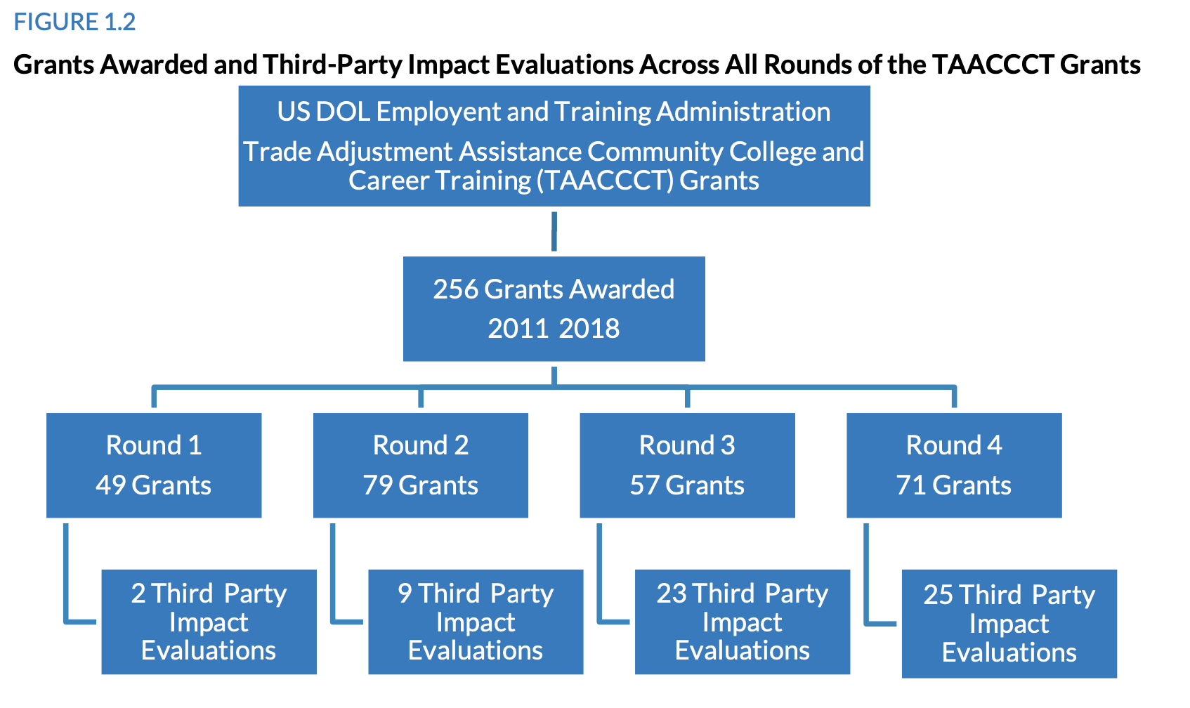
Overview

Slide 14
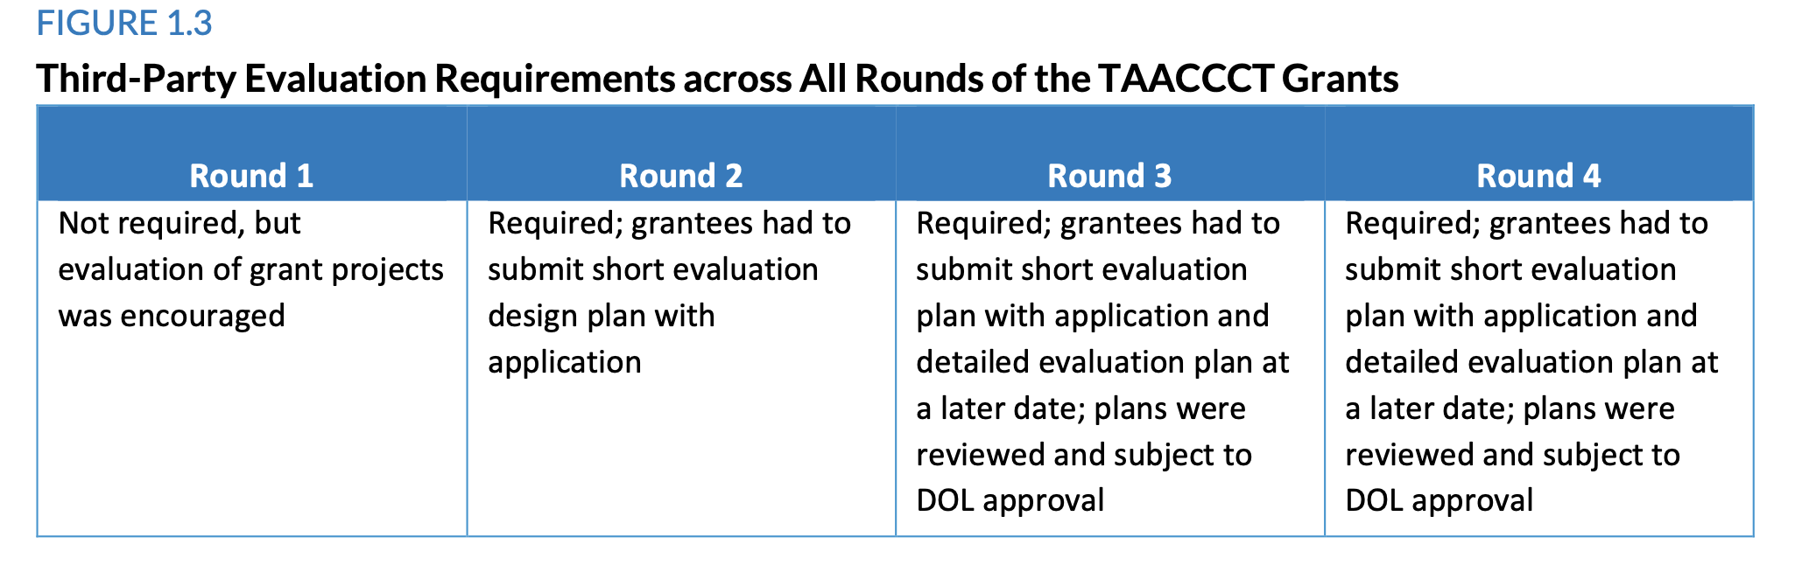
Impact Evaluation

Slide 15
Impact Evaluation Findings
Relevant outcomes were
Credential attainment
Program completion
Other educational outcomes
Employment
Wages and earnings

Slide 16
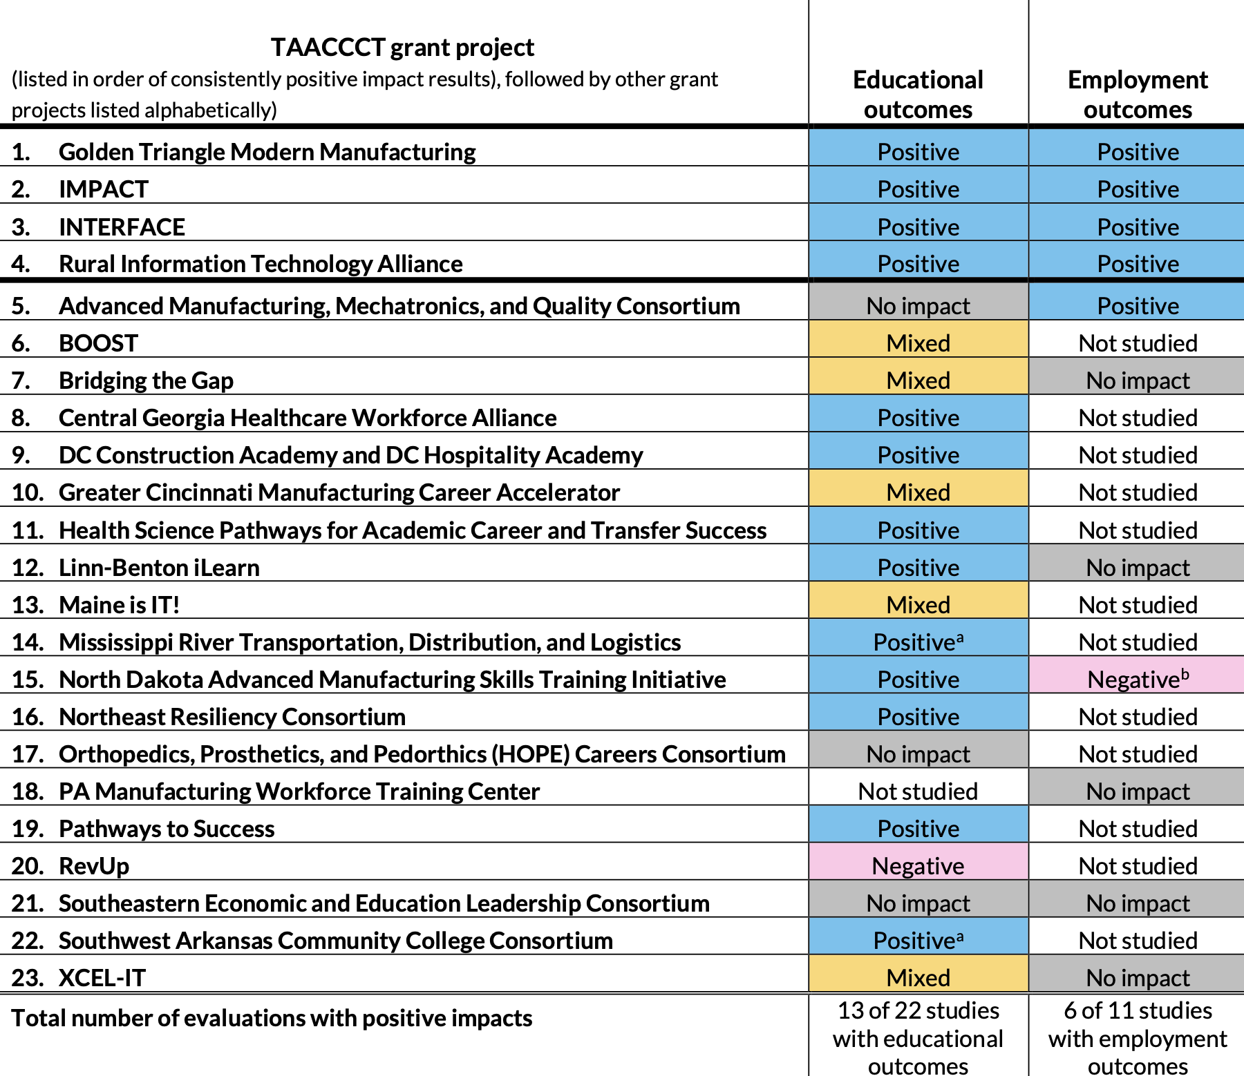

Slide 17
Detailed Impact Evaluations

Slide 18
Golden Triangle Modern Manufacturing
Final Evaluation Golden Triangle Modern Manufacturing Project (Harpole, 2017)
This evaluation focuses on the Golden Triangle region in Mississippi: Clay, Lowndes, and Oktibbeha counties
East Mississippi Community College (EMCC) consulted with employers to determine skills demanded for targeted industries and occupations
They modernized the Career and Technical Education (CTE) division for credential-based, short-term training targeted at advanced manufacturing
Added 3 credential-based, craft-level technician programs
Created a new 15-hour CTE development program
Expanded Clay County campus to meet increased industry demands
Engaged with employers in program design and advisory council
Source: https://www.skillscommons.org/bitstream/handle/taaccct/15669/Final%20Evaluation%20Golden%20Triangle%20Modern%20Manufacturing%20Project.pdf?sequence=1&isAllowed=y

Slide 19
Golden Triangle Modern Manufacturing
Program Strategies
Build program to meet industry demand
Enhance career pathway options for learners and workers
Accelerate and improve certification and employment attainment
Strengthen online and technology-enabled learning

Slide 20
Golden Triangle Modern Manufacturing
Outcomes of Interest
Academic: Retention rate, completion rate, and rate of additional education
Labor: Employment, job retention, and earning
Data
Structured interviews
Student Records
Baseline data
N=921
Comparison group
Historical CTE cohort

Slide 21
Golden Triangle Modern Manufacturing
Methodology
Calculate the ATT
Propensity Score Matching with Stata -teffects- psmatch
K-nearest neighbor matching with $K=2$
Covariates
Age, sex, race (binary), incumbent worker, enrollment status (full-time vs part-time), prior educational attainment, and program type
Balance diagnostics
Examined the distribution of propensity scores and summary statistics

Slide 22
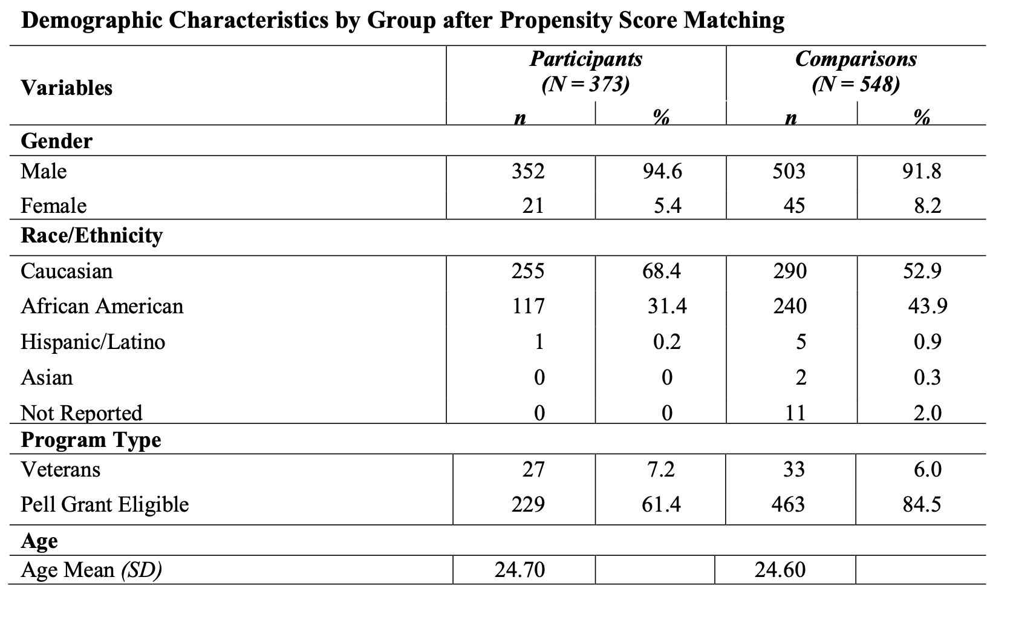
Golden Triangle Modern Manufacturing

Slide 23
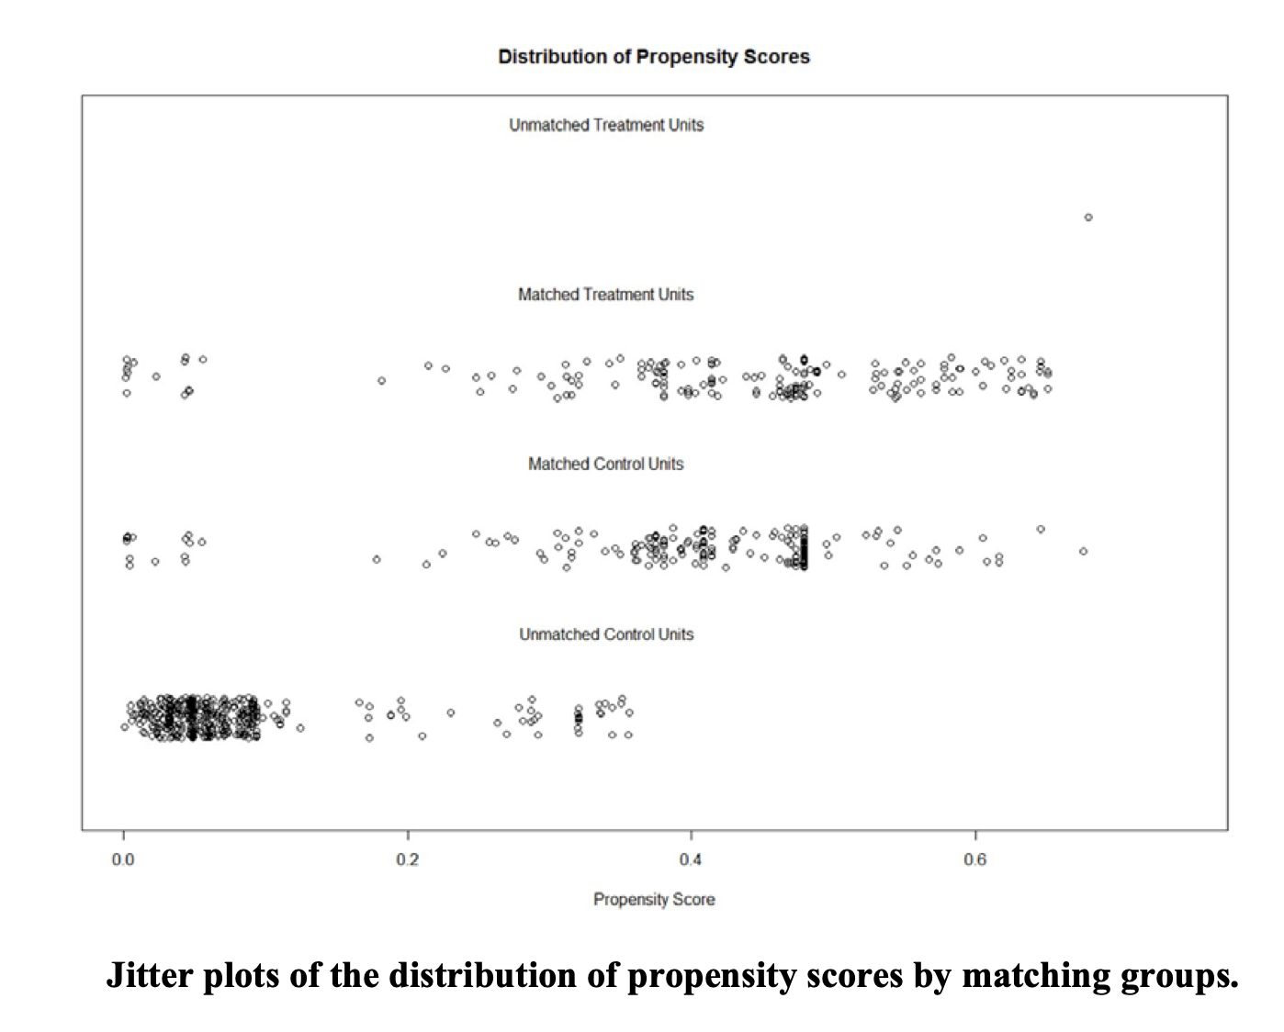
Golden Triangle Modern Manufacturing

Slide 24
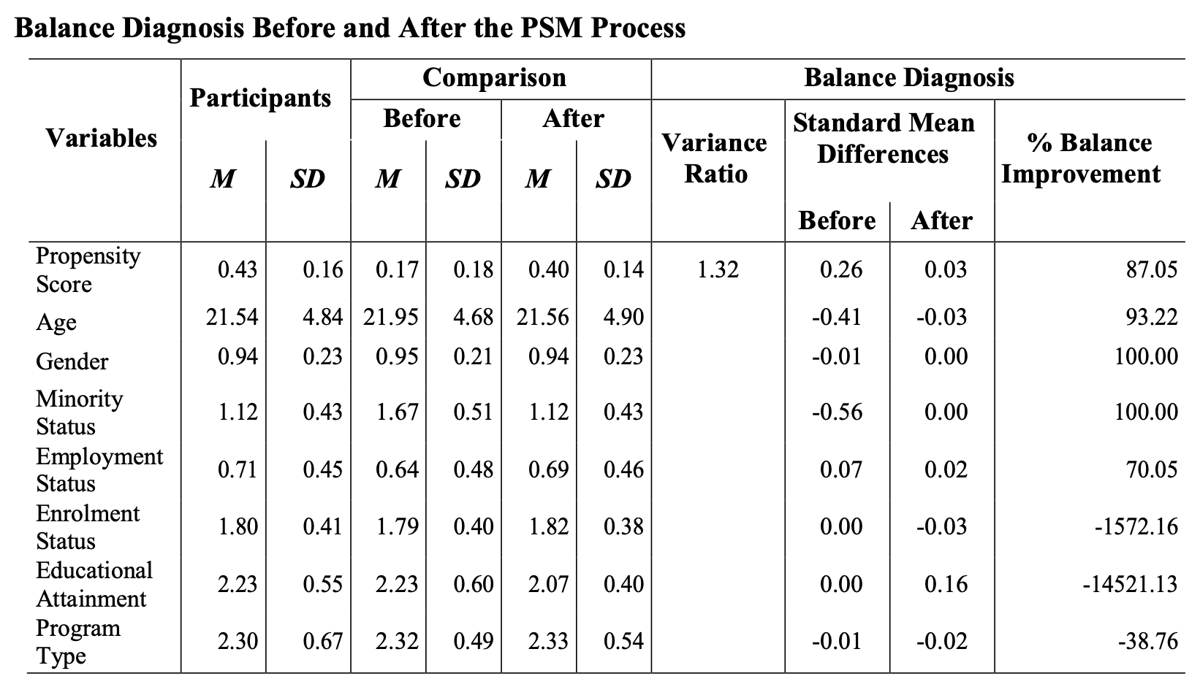
Golden Triangle Modern Manufacturing

Slide 25
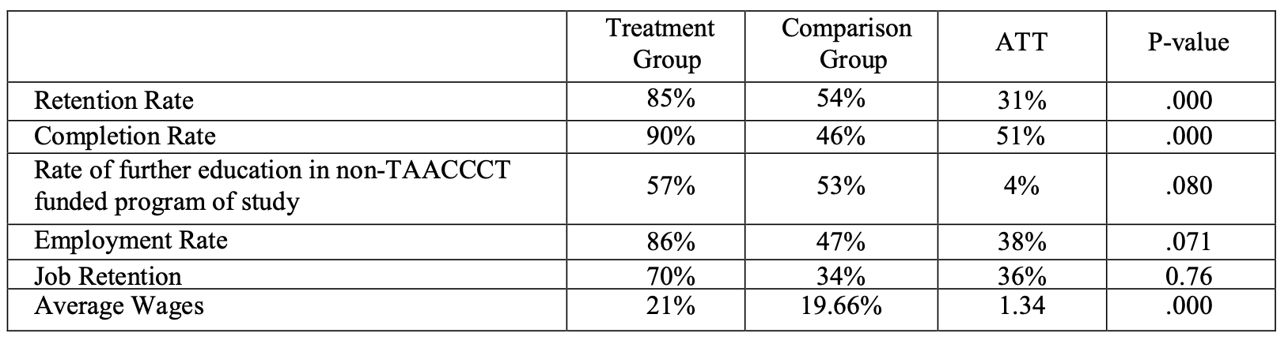
Golden Triangle Modern Manufacturing

Slide 26
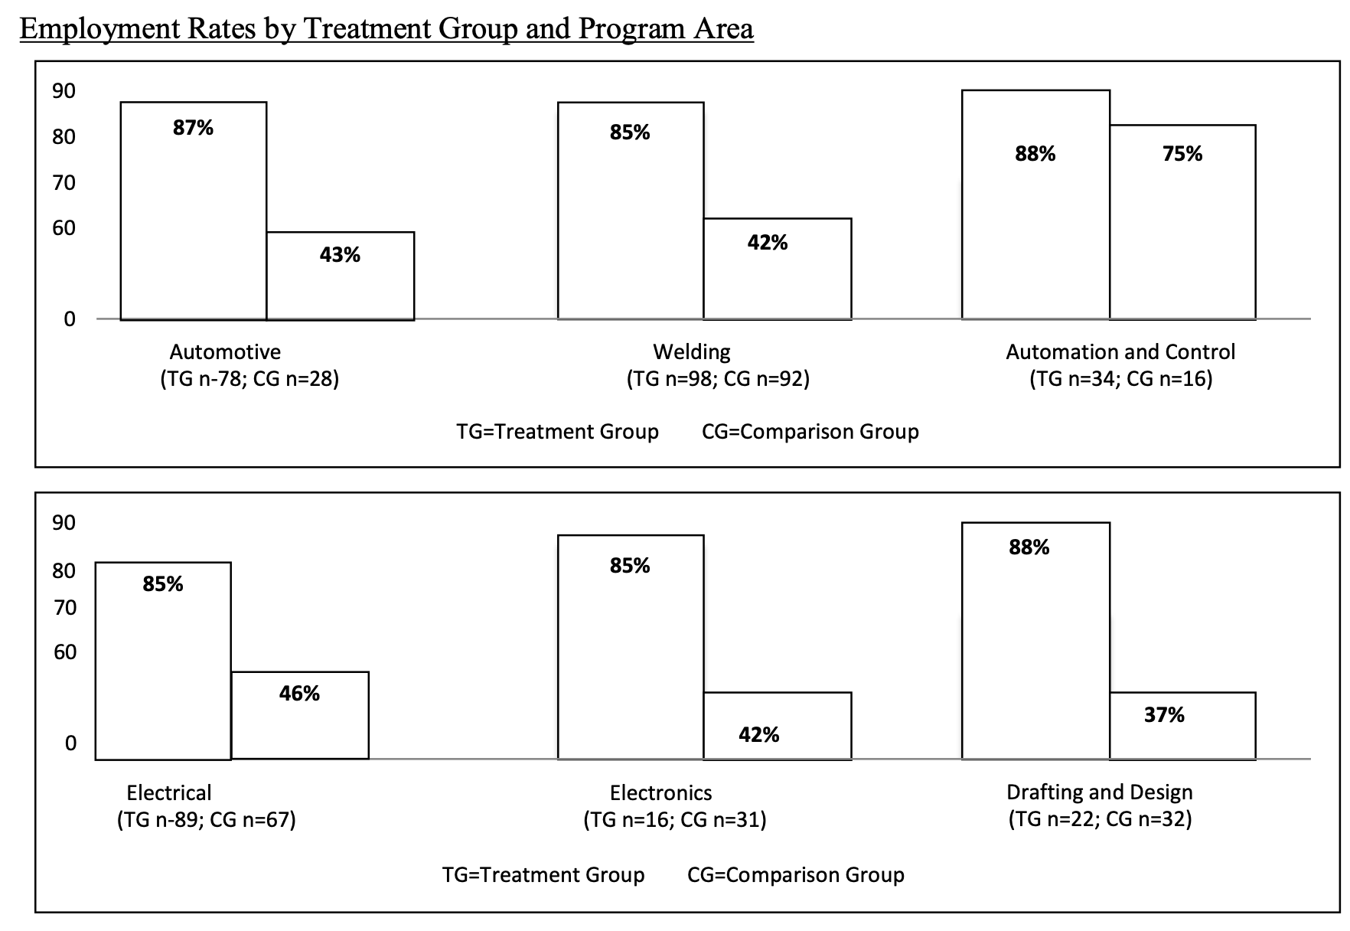
Golden Triangle Modern Manufacturing

Slide 27
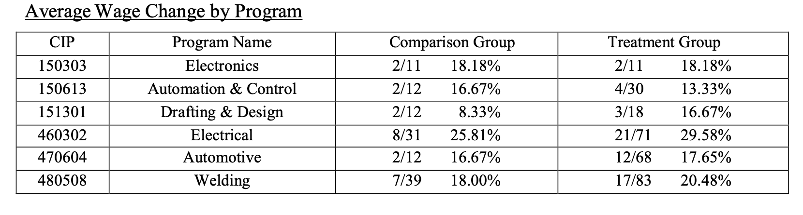
Golden Triangle Modern Manufacturing

Slide 28
Project IMPACT
Innovative Multi-Industry Partnership and Career Training (IMPACT) Project Gateway Community & Technical College Evaluation (Jensen, Horohov, and Waddington, 2017)
Focused on the Gateway Community & Technical College in Kentucky near the Kentucky-Ohio border
The primary goals of Project IMPACT were to enhance accelerated career pathways for logistics, manufacturing, heating & cooling, and energy fields
The program provided a combination of intensive academic and career coaching in cooperation with industry employers, workforce development authorities, and local agencies
Targeted students were TAACCCT-eligible students, veterans, and other “busy” adults
Source: https://www.skillscommons.org/bitstream/handle/taaccct/15674/IMPACT%20Final%20Evaluation%20Report.pdf?sequence=1&isAllowed=y

Slide 29
Project IMPACT
Program Strategies
Creating career pathways and developing new and enhanced curriculum and credentials for industries
Manufacturing, Utilities, Construction, and Transportation/Warehousing
Designing and enhancing programs and delivery
Integrating work-based learning opportunities, flexible delivery options, and online experiences
Transforming outreach, completion, and career support strategies to promote access and success
Focus on student support services and career mapping and forming new or existing partnerships between community and industry

Slide 30
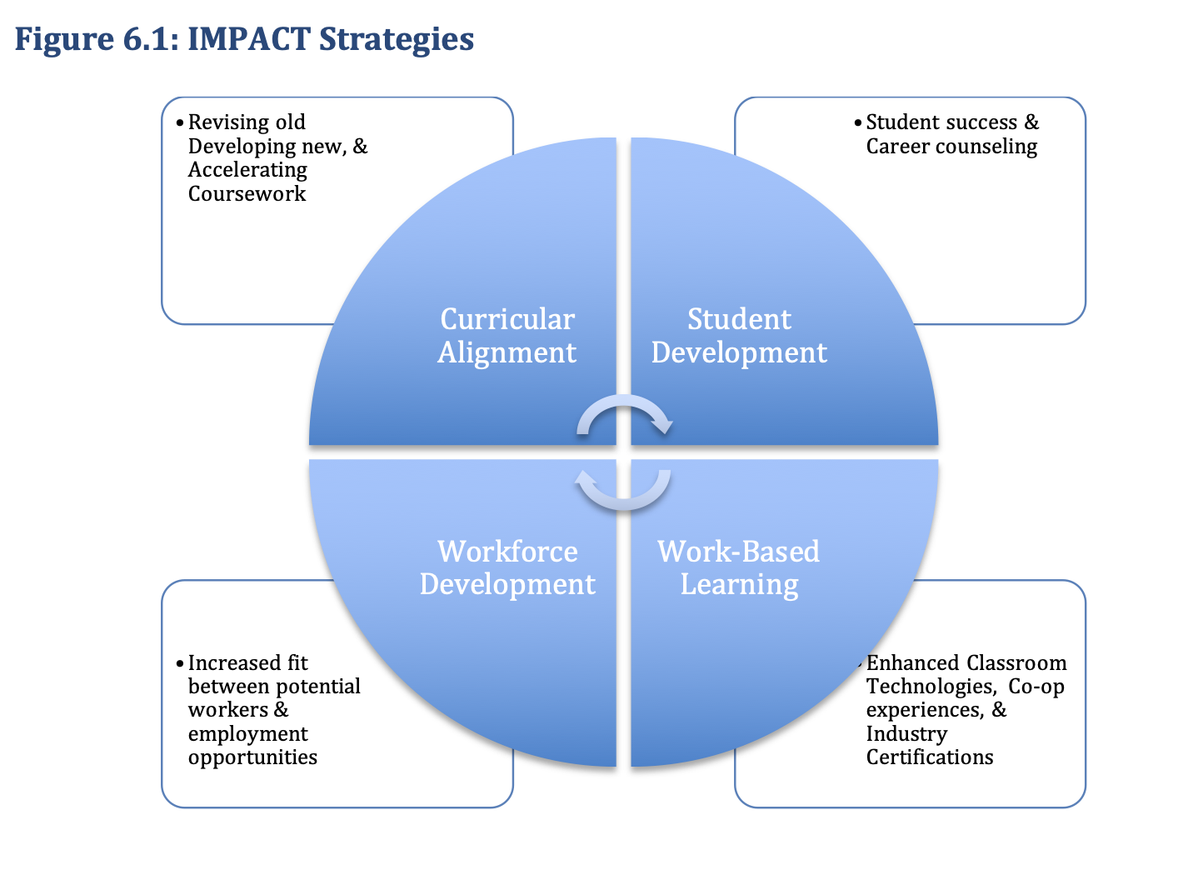
Project IMPACT

Slide 31
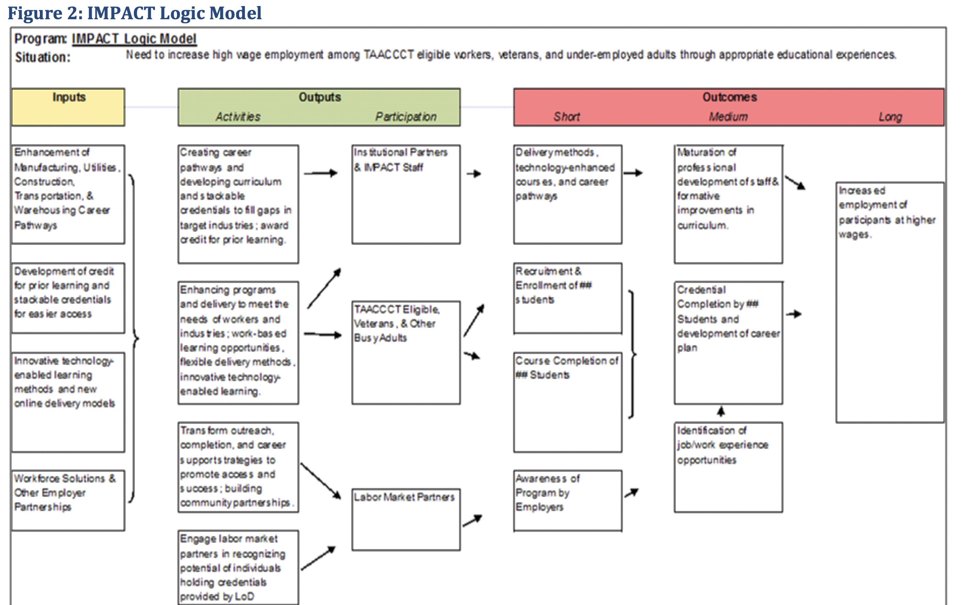

Slide 32
Project IMPACT
Outcomes of Interest
Academic: Courses taken, courses passed, earned credit, earned credential, and awarded credential
Labor: Employed, Change in quarterly wages
Data
Student records
State wage records from Kentucky Center for Workforce Statistics (KCEWS)
N=321
251 of 321 students were new students (non-incumbent to Gateway)
Comparison Group
Prior cohorts from affected program 2 years before reform

Slide 33
Project IMPACT
Methodology
Propensity score matching
Used caliper matching within 0.25 standard deviation of the overall score distribution
Matched 94.2 percent of treatment students to 127 comparison students
Covariates
Age, sex, race, Pell-eligible, part-time, veteran, and college readiness for English, reading, and math
Balance Diagnostics
Histograms of full sample and students who enrolled in Spring 2015 or later (“Full” IMPACT)
Do not discuss trimming, but unmatched students were left out

Slide 34
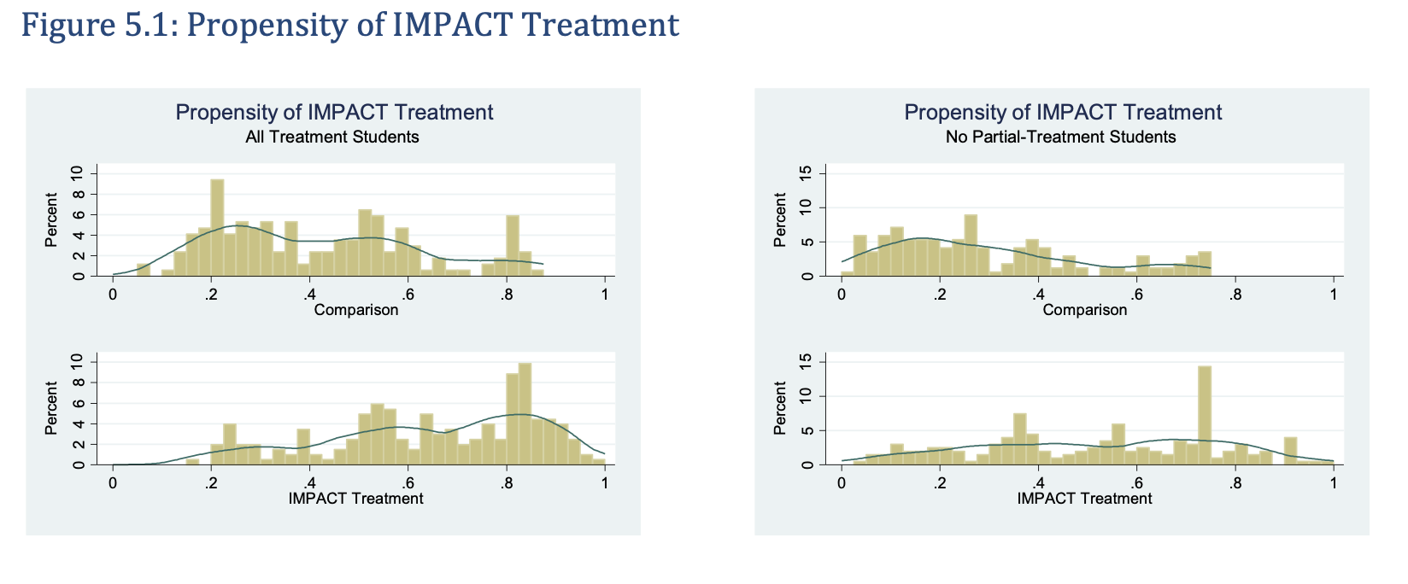
Project IMPACT

Slide 35
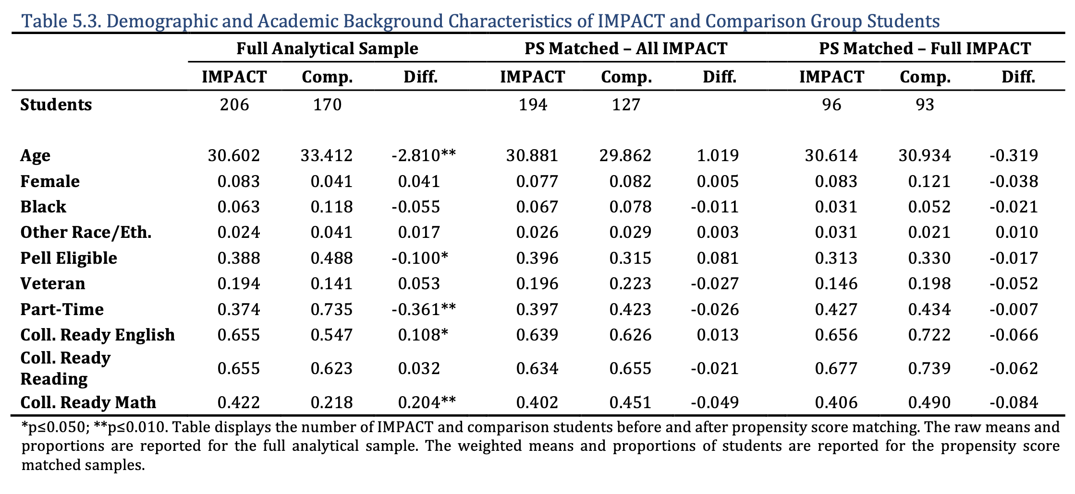
Project IMPACT

Slide 36
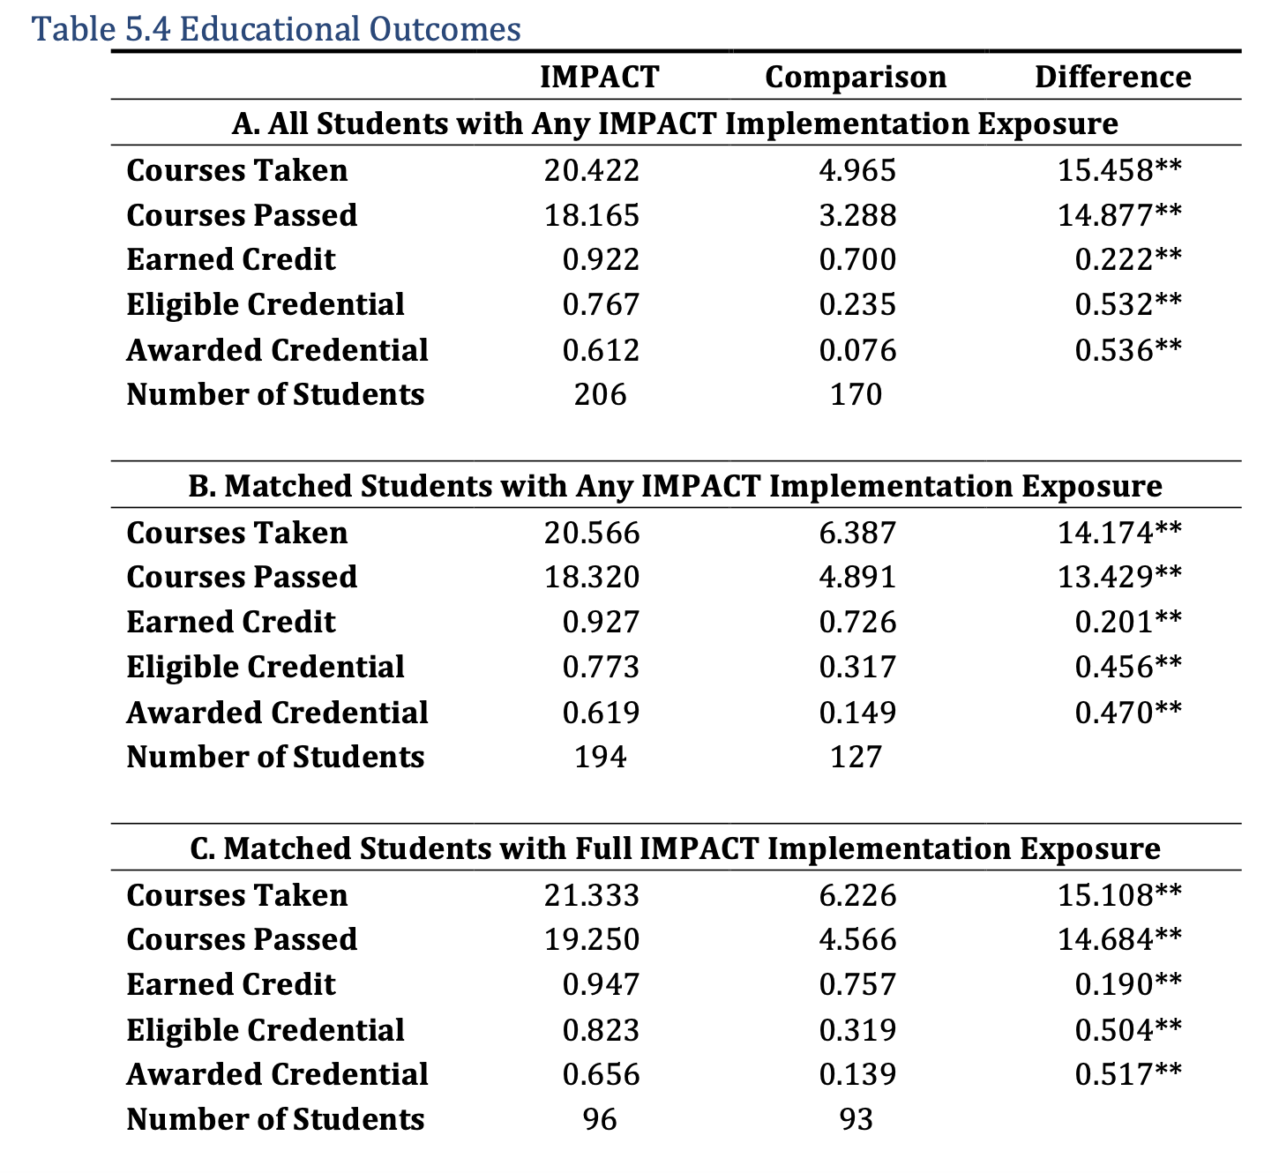
Project IMPACT

Slide 37
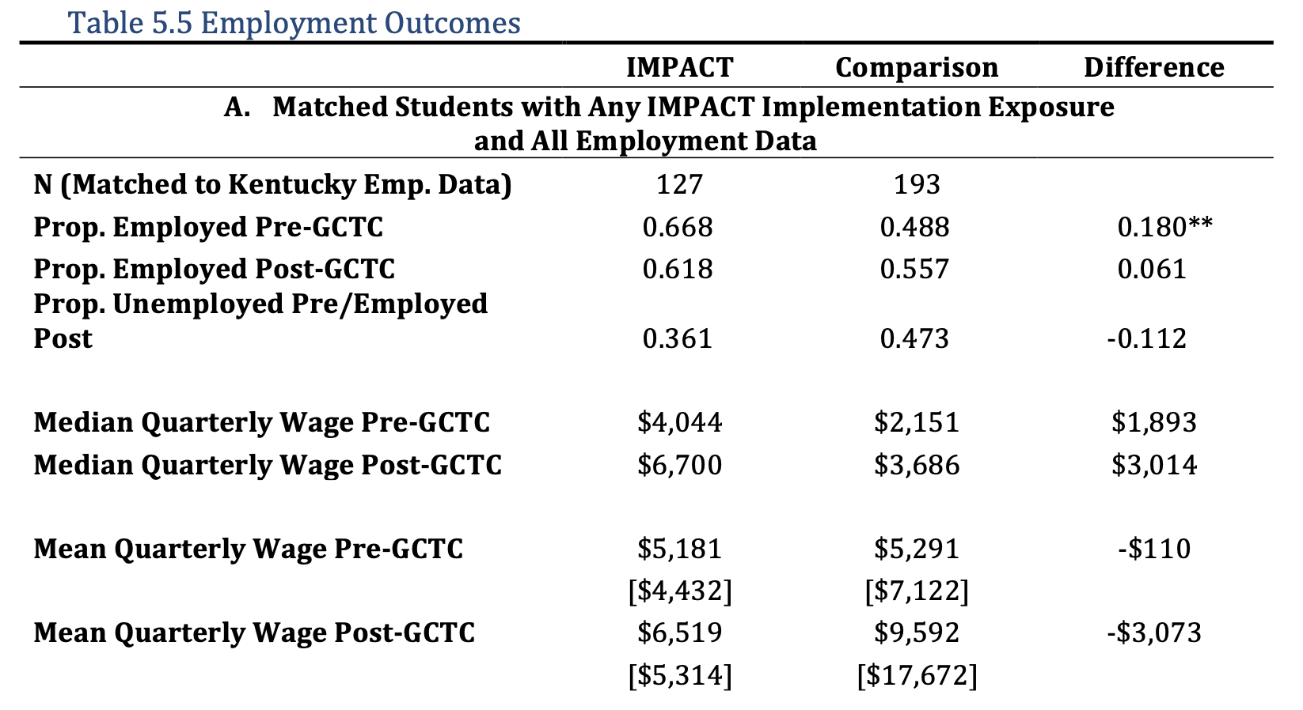
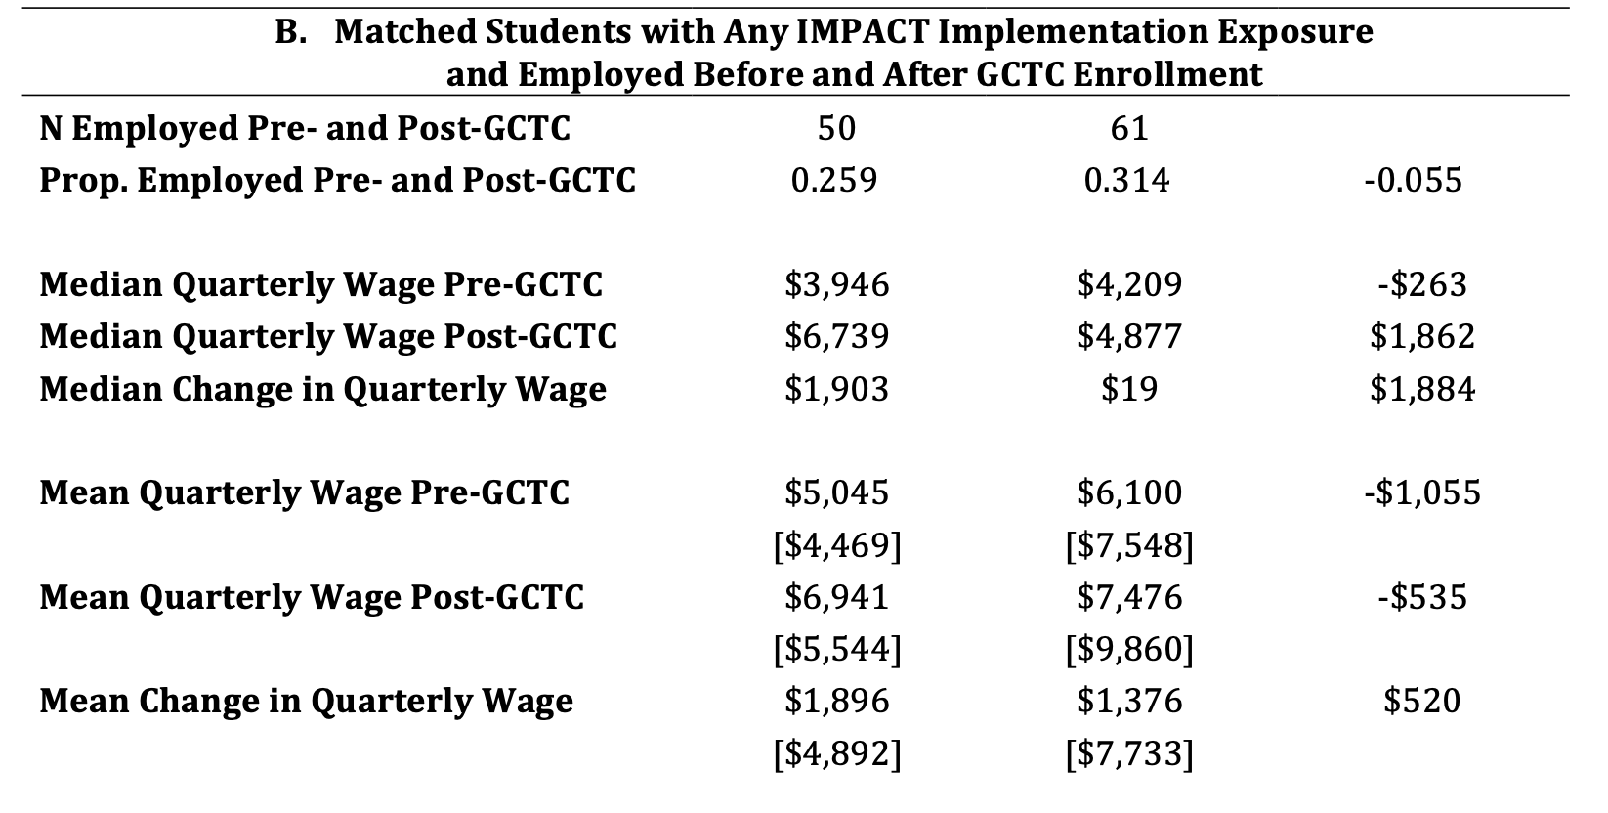
Project IMPACT

Slide 38
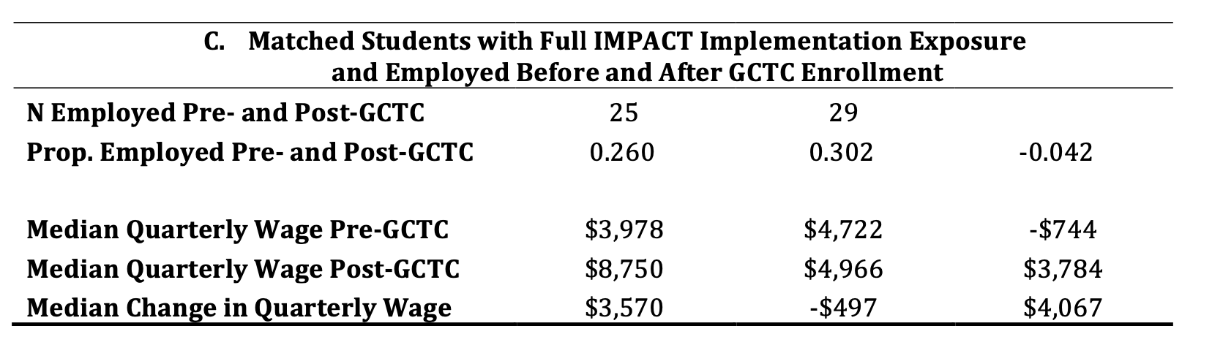
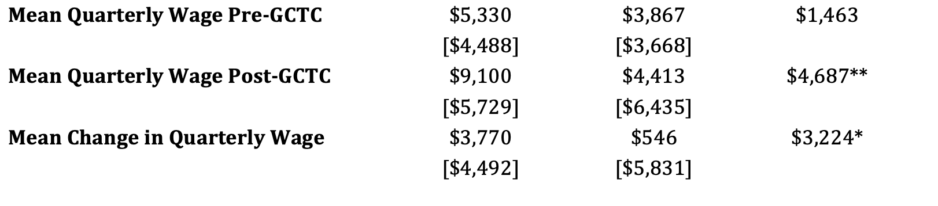
Project IMPACT

Slide 39
Final Thoughts
What is good comparison groups?
Prior cohorts were used frequently. Is this appropriate or sufficient?
If the PSM estimator satisfies the backdoor criterion and identifies the casual effect of TAACCCT training programs
What components of TAACCCT were effective? There were many strategies employed. Which ones worked and why?
What are scenarios where unobserved confounder will bias our results?

